Slide 1
Morse Code Translator
Rafi, Anas, Muayad, and Yiwen

Slide 2

Goal/Motivation
Notes:
Recently we found ourselves trapped in a maze prison with nothing but a telegraph.
The people who trapped us said that the only way we could receive help was via morse code instructions from someone on the outside. Not having a morse code translator, the process of writing down dots and dashes by hand and translating them manually was laborious.
When we eventually made it out of the maze, we decided that we would never have to go through the grueling task of writing morse code. We got straight to work designing a logic device that can translate morse code for us.

Slide 3
Short Functionality
Given a combination of inputs in morse code (dots = 1 and dashes = 0), our machine will decode and display the resulting ASCII text on the 7 segment display (for now). There will be three buttons used, one for morse value “dash”, another for “dot”, and lastly “translate” which initializes the statement set from the other buttons. After “translate” is pressed, the corresponding ASCII character will be displayed on the seven segment display (for now).
A B C D E F G H I J K L M N O P Q R S T U V W X Y Z

Slide 4
Short Specification
-Input (3 Buttons, Dash , Dot , and “Enter”)
-Clk, for each Debouncer
-Seven_segment display
-Finite State Machine with a Decoder (Translate w/e input ) based on number of input bits
-Debouncer
-Translation Module (T2M)

Slide 5
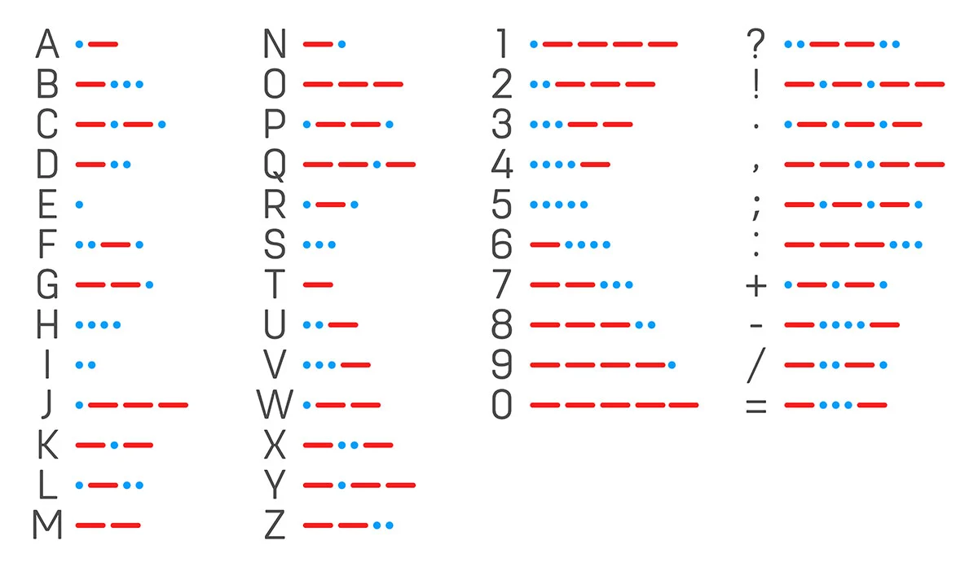
The Decoder Issue - A and Q

Slide 6
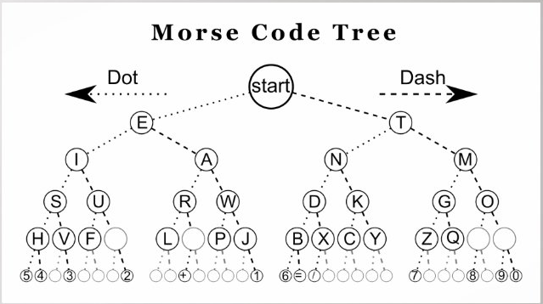
The Decoder Issue
level 0 →
level 1 →
level 2 →
level 3 →

Slide 7
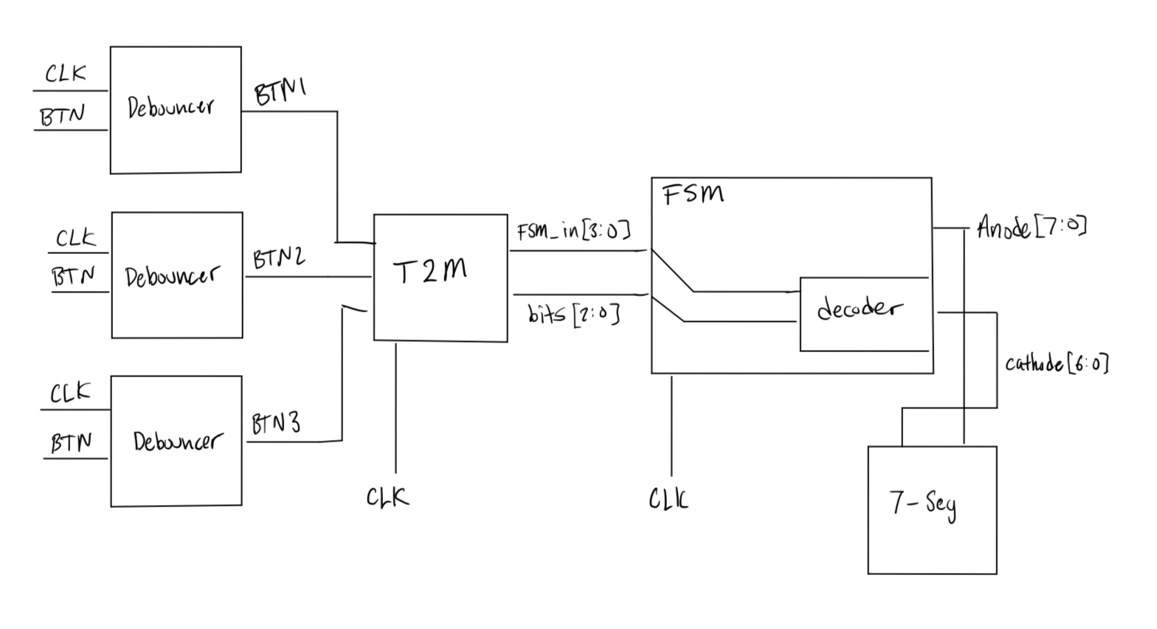
Detailed Block Diagrams
Morse to Text
Translator

Slide 8
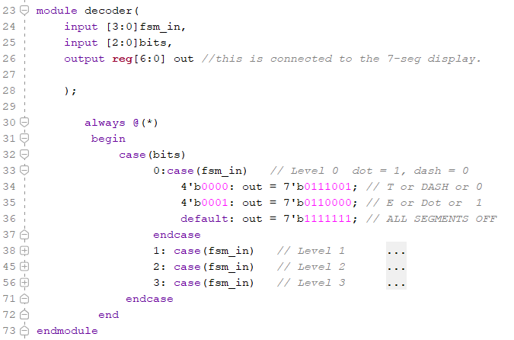
Code Snippet - Decoder

Slide 9
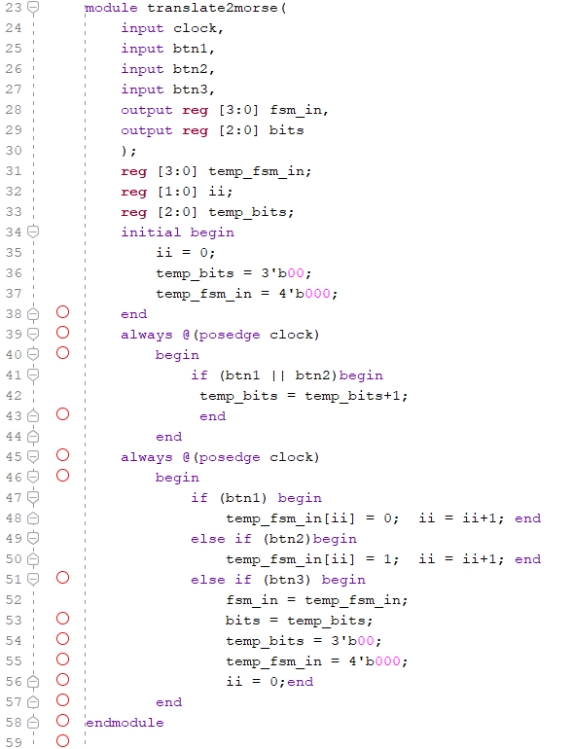
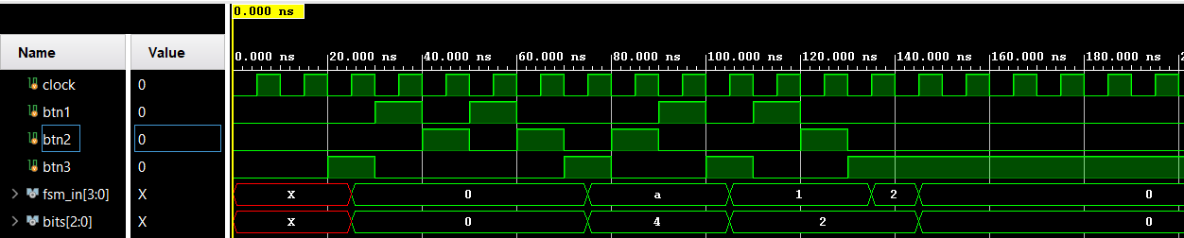
Code Snippet - Translator
Description: This module reads input from btn1, btn2 and counts when either is clicked. These values go into temp variables and once btn3 is clicked, we assign the outputs to the temp variables.
btn1=0 (dash) btn2 = 1 (dot) btn3 = upd

Slide 10
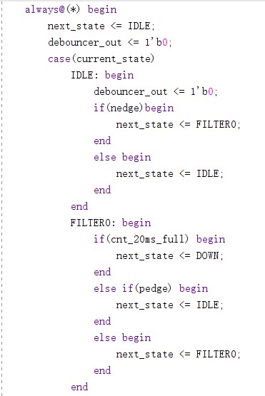
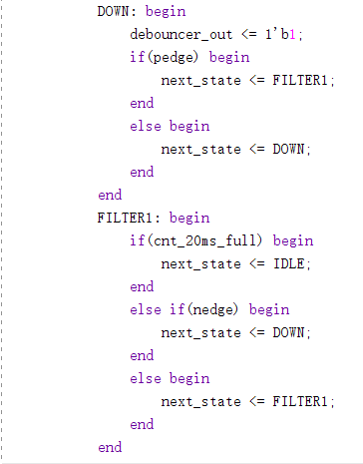
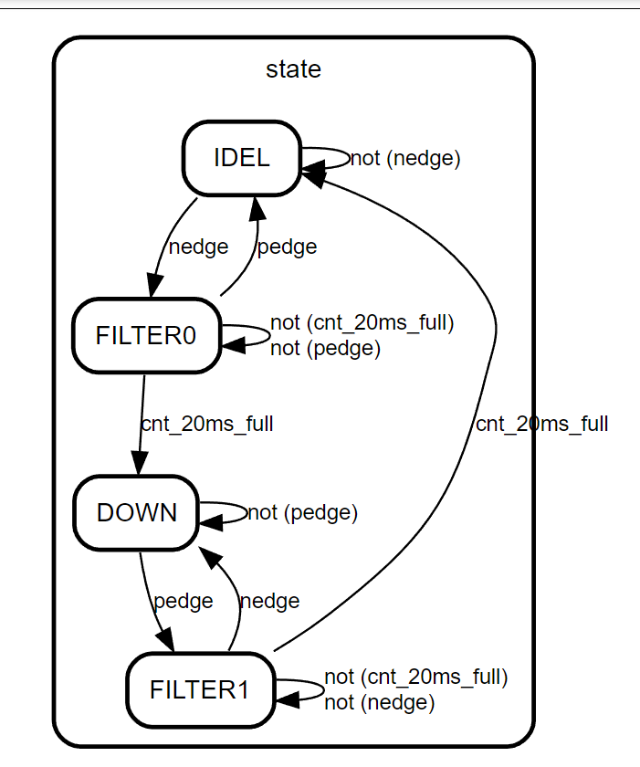
Code Snippet - Debouncer

Slide 11
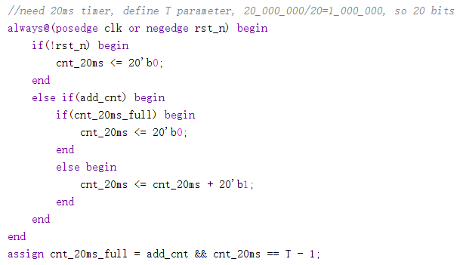
Code Snippet - Debouncer

Slide 12
Successes
Able to construct a proper block diagram expressing a method to translating morse
Resolved the issue with the decoder, by implementing a mux that changes how the decoder translates input

Slide 13
Failures
Use a VGA to properly display output (translated morse code)
Not sure how to implement everything with the FSM yet.
Unable to test functionality on an FPGA due to flooding in the labs.

Slide 14
Questions?

